Slide 1


Session 3 SQL COMMANDS
Trainer: Ms Shirley Komogi
Centre of Excellence in IT

Slide 2

Contents
Session 2 review
Introduction to SQL commands
Types of SQL commands
Core SQL commands you need to know

Slide 3
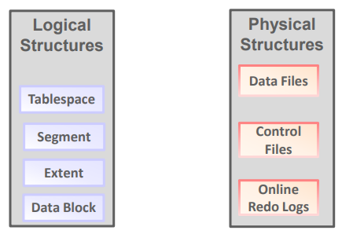
Session 2 Review
Data Storage Structures (Physical & Logical structures, Structured/Unstructured & Semi-structured)
Notes:
Physical – COD (Control file, online Redo Logs, Data files)
Logical – TEDS (Tablespace, Extent, Data block, Segment)
data file is a physical file on disk that was created by Database and contains data structures such as tables and indexes.
Online Redo logs- two or more pre-allocated files that store changes to the database as they occur.
Control file is a small binary file associated with only one DB. It has 2 parts to it (DB name & unique DBID) and contains/holds the 1. time stamp of the DB creation, and 2. info about online redo log files and data files.
Tablespace:A tablespace is a database storage unit that contains one or more segments (ie one to many) but one/each segment belongs to one and only one tablespace (1-1 rel)
Extent:An extent is a set of logically contiguous data blocks allocated for storing a specific type of information
Data block: A data block is the smallest logical storage unit of a database. A block represents a specific number of bytes on the physical hard disk.
Segment: A segment is a set of extents allocated for a specific database object, such as a table.
Structured data: easily accessible given row and column headers to go by, eg an excel spreadsheet.
Unstructured data: Cannot be easily accessible eg: audio, video files, image files (photo), textual files (.txt extension https://www.computerhope.com/jargon/a/kirk.txt) contains text and has no special formatting such as bold text, italic text, images, etc
Semi structured files: a form of structured data that does not conform with the formal structure of data models associated with relational databases or other forms of data tables,
but nonetheless contain tags or other markers to separate semantic elements and enforce hierarchies of records and fields within the data. Many tools are now available to read semi-structured files. Eg JSON (java script object notation formatted file that stores simple data structure and objects used for transmitting data between a web app and a server) JSON is text, and we can convert any JavaScript object into JSON, and send JSON to the server.
We can also convert any JSON received from the server into JavaScript objects.
If you have data stored in a JavaScript object, you can convert the object into JSON, and send it to a server: https://www.w3schools.com/js/js_json_intro.asp
and XML https://www.w3schools.com/xml/simple.xml (Extensible Mark up Language- defines a set of rules for encoding a document in a format both human readable and machine readable) files.

Slide 4
Introduction to SQL Commands
Structured Query Language(SQL) commands are instructions.
It is used to communicate with the database. It is also used to perform specific tasks, functions, and queries of data.
SQL can perform various tasks like create a table, add data to tables, drop the table, modify the table, set permission for users.
.

Slide 5
Types of SQL Commands
SQL commands are mainly categorized into five categories as:
DDL – Data Definition Language
DQl – Data Query Language
DML – Data Manipulation Language
DCL – Data Control Language
TCL – Transaction Control Language
Notes:
Formerly, was four categories until TCL was included.

Slide 6
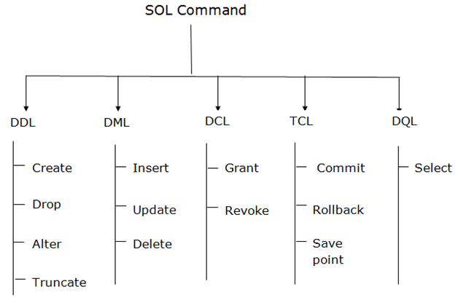
Types of SQL Commands
Notes:
Formerly, was four categories until TCL was included. DDL (C-DAT), DML (IUD), DCL (GR), TCL (CRS), DQl (S)

Slide 7
1. Data Definition Language (DDL)
DDL or Data Definition Language actually consists of the SQL commands that can be used to define the database schema. It simply deals with descriptions of the database schema and is used to create and modify the structure of database objects in the database.
Examples of DDL commands:
CREATE – is used to create the database or its objects (like table, index, function, views, store procedure and triggers).
DROP – is used to delete objects from the database.
ALTER-is used to alter the structure of the database.
TRUNCATE–is used to remove all records from a table, including all spaces allocated for the records are removed.
COMMENT –is used to add comments to the data dictionary.
RENAME –is used to rename an object existing in the database.
Notes:
DDL changes the structure of the table like creating a table, deleting a table, altering a table, etc.
All the command of DDL are auto-committed that means it permanently save all the changes in the database.
There are two CREATE statements available in SQL:
CREATE DATABASE
CREATE TABLE

Slide 8
DDL – CREATE statement
There are two CREATE statements available in SQL:
CREATE DATABASE
CREATE TABLE
Example 1: This query will create a new database in SQL and name the database as my_database.
CREATE DATABASE my_database;
Example 2:
This query will create a table named Students with three columns, ROLL_NO, NAME and SUBJECT.
CREATE TABLE Students
(
ROLL_NO int(3),
NAME varchar(20),
SUBJECT varchar(20),
);
Notes:
DDL changes the structure of the table like creating a table, deleting a table, altering a table, etc.
All the command of DDL are auto-committed that means it permanently save all the changes in the database.
There are two CREATE statements available in SQL:
CREATE DATABASE
CREATE TABLE

Slide 9
DDL – DROP statement
DROP is used to delete a whole database or just a table.
Syntax:
DROP object object_name
Example 1:
DROP TABLE table_name;
table_name: Name of the table to be deleted.
Example 2
DROP DATABASE database_name;
database_name: Name of the database to be deleted.
Here, table is deleted with its full structure.
Notes:
The DROP statement destroys the objects like an existing database, table, index, or view. A DROP statement in SQL removes a component from a relational database management system (RDBMS). (Is it case sensitive? The key words are case-INSENSITIVE. However in some set ups, table & column names are case-sensitive.

Slide 10
DDL – ALTER statement
ALTER: It is used to alter the structure of the database. This change could be either to modify the characteristics of an existing attribute or probably to add a new attribute.
Syntax:
To add a new column in the table, ALTER TABLE table_name ADD column_name COLUMN-definition;
To modify existing column in the table:
ALTER TABLE MODIFY(COLUMN DEFINITION....);
Example 1:
DROP TABLE table_name;
table_name: Name of the table to be deleted.
Example 2
DROP DATABASE database_name;
database_name: Name of the database to be deleted.

Slide 11
DDL – TRUNCATE statement TRUNCATE is used to delete all the rows from the table and free the space containing the table. Truncate preserves the structure of the table for future use. Syntax: TRUNCATE TABLE table_name; Example: TRUNCATE TABLE EMPLOYEE;
Notes:
is used to remove all records from a table, including all spaces allocated for the records are removed.
DROP vs TRUNCATE
Truncate is normally ultra-fast and its ideal for deleting data from a temporary table.
Truncate preserves the structure of the table for future use, unlike drop table where the table is deleted with its full structure.
Table or Database deletion using DROP statement cannot be rolled back, so it must be used wisely.

Slide 12
DDL – COMMENT statement
COMMENT –is used to add comments to the data dictionary.
Comments can be written in the following three formats:
Single line comments.
Multi line comments
In line comments
Single line comments: Comments starting and ending in a single line. Line starting with ‘–‘ is a comment and will not be executed. Example: --another comment
Multi line comments: Comments starting in one line and ending in different line
Example: /* multi line comment
another comment */
In line comments: In line comments are an extension of multi line comments, comments can be stated in between the statements and are enclosed in between ‘/*’ and ‘*/’. Example: SELECT * FROM /* Customers; */
Notes:
As is any programming languages comments matter a lot in SQL also. In this set we will learn about writing comments in any SQL snippet.
Line starting with ‘/*’ is considered as starting point of comment and are terminated when ‘*/’ is encountered.

Slide 13
DDL – RENAME statement
RENAME –is used to rename an object existing in the database.
syntax
RENAME TABLE old_table_name to new_table_name
example
RENAME TABLE student to students_info;

Slide 14
2. Data Manipulation Language (DML)
Data Manipulation Language
DML commands are used to modify the database. It is responsible for all form of changes in the database.
The command of DML is not auto-committed that means it can't permanently save all the changes in the database. They can be rollback.
Here are some commands that come under DML:
INSERT
UPDATE
DELETE

Slide 15
DML – INSERT statement
INSERT is used to insert a new row in a table. There are two ways of using INSERT INTO statement for inserting rows:
1. Only values: First method is to specify only the value of data to be inserted without the column names.
INSERT INTO table_name VALUES (value1, value2, value3,…);
table_name : name of the table. value1, value2,.. : value of first column, second column,… for the new record
2. Column names and values both: In the second method we will specify both the columns which we want to fill and their corresponding values as shown below:
INSERT INTO table_name (column1, column2, column3,..) VALUES ( value1, value2, value3,..);
column1 : name of first column, second column …
Notes:
Example: https://www.techonthenet.com/sql/insert_ddl.php

Slide 16
DML – UPDATE statement
UPDATE is used to update the data of an existing table in database. We can update single columns as well as multiple columns using UPDATE statement
SYNTAX
UPDATE table_name SET column1 = value1, column2 = value2,...
WHERE condition;
table_name name of the table
column1 : name of first , second, third column....
value1 : new value for first, second, third column....
condition : condition to select the rows for which the values of columns needs to be
updated.
Notes:
NOTE: In the above query the SET statement is used to set new values to the particular column and the WHERE clause is used to select the rows for which the columns are needed to be updated. If we have not used the WHERE clause then the columns in all the rows will be updated. So the WHERE clause is used to choose the particular rows.

Slide 17
DML – DELETE statement
The DELETE Statement in SQL is used to delete existing records from a table. We can delete a single record or multiple records depending on the condition we specify in the WHERE clause.
Syntax
DELETE FROM table_name WHERE some_condition;
Notes:
table_name: name of the table
some_condition: condition to choose particular record.
Note: We can delete single as well as multiple records depending on the condition we provide in WHERE clause. If we omit the WHERE clause then all of the records will be deleted and the table will be empty.

Slide 18
3. Data Control Language (DCL)
DCL commands are used to grant and take back authority from any database user.
Here are some commands that come under DCL:
Grant
Revoke
Grant: It is used to give user access privileges to a database
GRANT SELECT, UPDATE ON MY_TABLE TO SOME_USER, ANOTHER_USER;
Revoke: It is used to take back permissions from the user.
REVOKE SELECT, UPDATE ON MY_TABLE FROM USER1, USER2;

Slide 19
4. Transaction Control Language (TCL)
TCL commands can only be used with DML commands like INSERT, DELETE and UPDATE only.
These operations are automatically committed in the database that's why they cannot be used while creating tables or dropping them.
Here are some commands that come under TCL:
COMMIT used to save all the transactions to the database.
Syntax: COMMIT;
ROLLBACK used to undo transactions that have not already been saved to the database.
Syntax: ROLLBACK;
SAVEPOINT used to roll the transaction back to a certain point without rolling back the entire transaction.
Syntax: SAVEPOINT SAVEPOINT_NAME;
Notes:
Example:
DELETE FROM CUSTOMERS
WHERE AGE = 25;
COMMIT;
-----------------------------------------------------------------------------
DELETE FROM CUSTOMERS
WHERE AGE = 25;
ROLLBACK;
-----------------------------------------------------------------
DELETE FROM CUSTOMERS
WHERE AGE = 25;
SAVEPOINT pt1;

Slide 20
5. Data Query Language (DQL)
DQL is used to fetch the data from the database.
It uses only one command:
SELECT is used to select the attribute based on the condition described by WHERE clause.
Syntax:
SELECT expressions
FROM TABLES
WHERE conditions;
For example:
SELECT emp_name
FROM employee
WHERE age > 20;

Slide 21


